Slide 1
Computer based system engineering

Slide 2
System engineering
Is an activity of specifying, designing, implementing, validating, deploying and maintaining systems as a whole.
System engineers are not only concerned with software but with software, hardware and the system interactions with users and its environment.
They must thing about the services that the system provides, the constraints under which the system must be built and operated and the interaction of the system with its environment.

Slide 3
introduction
System?
A system is a purposeful collection of interrelated components that work together to achieve some objective.
This general definition embraces a vast range of systems.
For example, a very simple system such as a pen may only include three or four hardware components.
By contrast, an air traffic control system includes thousands of hardware and software components plus human users who make decisions based on information from the computer system.

Slide 4
system
The successful functioning of each component depends on the functioning of some other components.
System are often hierarchical in that they include other systems.
Eg: a police command and control system may include a GIS to provide details of the location of incidents. These other systems are called sub-systems.
Feature of sub-system is that they can operate as independent systems in their own right. So same GIS system may be used in different systems.

Slide 5
Emergent properties
Properties of the system as a whole rather than properties that can be derived from the properties of components of a system
Emergent properties are a consequence of the relationships between system components
They can therefore only be assessed and measured once the components have been integrated into a system

Slide 6
Example of emergent properties
The overall weight of the system
This is an example of an emergent property that can be computed from individual component properties.
The reliability of the system
This depends on the reliability of system components and the relationships between the components.
The usability of a system
This is a complex property which is not simply dependent on the system hardware and software but also depends on the system operators and the environment where it is used.

Slide 7
Types of emergent properties
Emergent properties of the system are attributes of a system as a whole. They can only be measured once the sub systems have been integrated to form a complete system.
Functional properties
These appear when all the parts of a system work together to
achieve some objective. For example, a bicycle has the functional property of being a transportation device once it has been assembled from its components.
Non-functional properties
Examples are reliability, performance, safety, and security. These relate to the behavior of the system in its operational
environment. They are often critical for computer-based systems as failure to achieve some minimal defined level in these properties may make the system unusable.

Slide 8
System reliability
Reliability must be considered at system level rather than component level
Components of the system are interdependent so failure in one can be propagated through the system and affect the operation of other components.
System failures often occur because of unforeseen inter-relationships between components
It is probably impossible to anticipate all possible component relationships
System designer often can’t anticipate the failures and their propagation.

Slide 9
Influences on reliability of system
There are three closely related influences on the overall reliability of the system.
Hardware reliability
What is the probability of a hardware component failing and how long does it take to repair that component?
Software reliability
How likely is it that a software component will produce an
incorrect output. Software failure is usually distinct from hardware failure in that software does not wear out.
l
Operator reliability
How likely is it that the operator of a system will make an error?
AND ALL OF THEM ARE CLOSELY LINKED

Slide 10
System and their environment
Systems are not independent but exist in an environment
Environment affects the functioning and performance of the system
Eg: e.g. system may require electrical supply from its environment
Environment may be considered as system in its own right but, more generally, it consists of no of other systems which interact with each other.
System’s function may be to change its environment
The organizational as well as the physical environment may be important

Slide 11
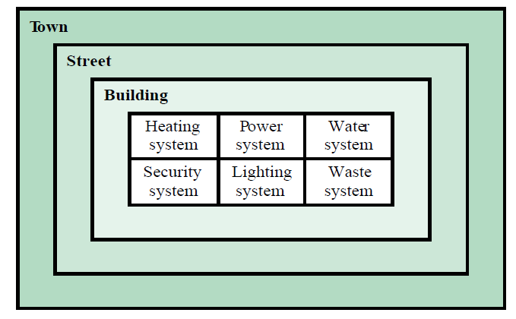
System and their environment
.

Slide 12
Why environment is important??
There are two main reasons why the environment of a system must be understood by system engineers.
In many cases, system is intended to make some changes in its environment. Therefore, a heating system changes its environment by increasing or decreasing its temperature. The correct functioning of the system can therefore only be assessed by the effects on the environment.
The functioning of a system can be affected by changes in its environment in ways which can be difficult to predict. The electrical system in a building may be affected by environmental changes outside the building. Works in the street outside may cut a power cable and so electricity system is disabled.

Slide 13
Human and organizational factors
Organizational environment includes policies and procedures that are themselves governed by political, economic, social and environmental issues.
Process changes
Does the system require changes o the work processes in the environment? If so, training will certainly be required. If changes are significant or if they involve people losing their jobs, there is a danger that the system will be resisted by the users.
Job changes
Does the system de-skill the users in an environment or cause them to change the way they work? If so, they my actively resist the introduction of the system into the organization.
Organizational changes
Does the system change the political power structure in an
organization?

Slide 14
System architecture modeling
An architectural model presents an abstract view of the sub-systems making up a system
May include major information flows between subsystems
Usually presented as a block diagram showing the major sub-systems and the interconnection between them.
Each sub system is represented by a rectangle in the block diagram.
Relationships between sub systems is indicated by arrows joining these rectangles.
The block diagram should be supplemented by brief descriptions of each sub-system.
The system is decomposed into functional components.
Functional components are components that, when viewed from the prospective of the sub system, provides a single function.
By contrast, a sub-system is multi functional.

Slide 15
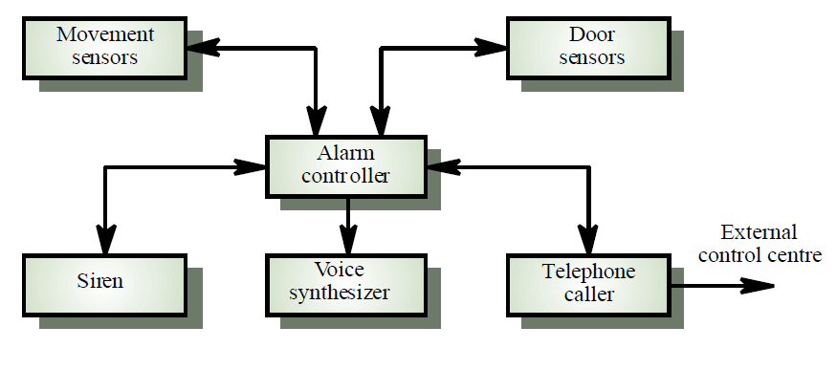
Simple intruder alarm system
.

Slide 16
Sub system functionality in IAS
Movement sensors: detects movement in the rooms monitored by the system
Door sensors: detects door opening in the external doors of the building
Alarm controller: controls the operation of the system
Siren: emits an audible warning when an intruder is suspected.
Voice synthesizer: synthesizes a voice message giving the location of the suspected intruder
Telephone caller: makes a external calls to notify security, the police, etc.

Slide 17
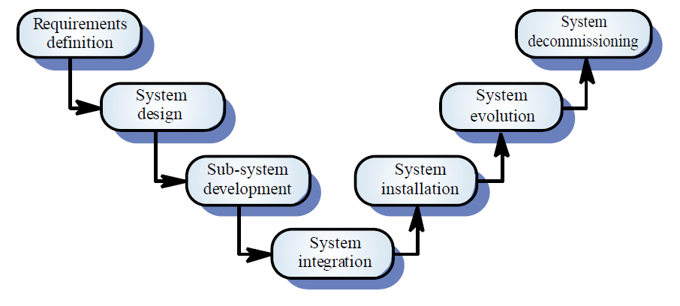
System engineering process
.

Slide 18
System engineering process
There are important distinctions between the system engineering process and software development process.
Interdisciplinary involvement: Many different engineering disciplines may be involved in system engineering. There is immense scope for misunderstanding because of different terminologies used by different engineers.
Reduced scope for rework during system development: Once some system engineering decisions have been made, they are very expensive to change.

Slide 19
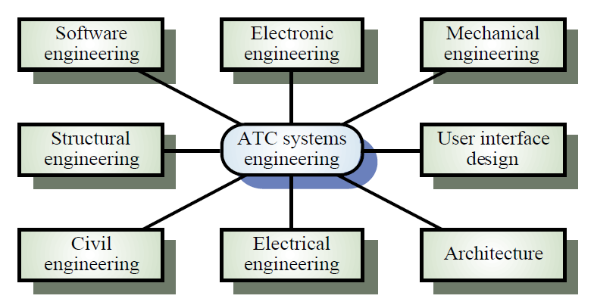
System engineering process
System engineering is an interdisciplinary activity involving teams drawn from different backgrounds.
Figure shows some of the different disciplines that may be involved in the system engineering team.

Slide 20
System requirements definition
It is intended to discover the requirements for the system as a whole.
It involves consultations with system customers and end users.
Three types of requirements are defined in this phase.
Abstract functional requirements: The basic functions that the system must provide are defined at an abstract level. Detailed functional requirements specification takes place at the sub-system level.
System properties: Non-functional requirements of the system are defined in general. These may include availability, performance, safety, etc.
Undesirable properties: Unacceptable system behavior is specified.
Should also define overall objectives of the system

Slide 21
System objectives
Functional objectives
To provide a fire and intruder alarm system for the building which will provide internal and external warning of fire or unauthorized intrusion
Organizational objectives
To ensure that the normal functioning of work carried out in the building is not seriously disrupted by events such as fire and unauthorized intrusion

Slide 22
System requirement problems
Changing as the system is being specified
Must anticipate hardware/communications developments over the lifetime of the system
Hard to define non-functional requirements (particularly) without an impression of component structure of the system.
Wicked problem
Is a problem which is so complex and where there are so many related entities that there is no definitive problem specification.
Eg earthquake planning
The problem is tackled when after it happens.

Slide 23
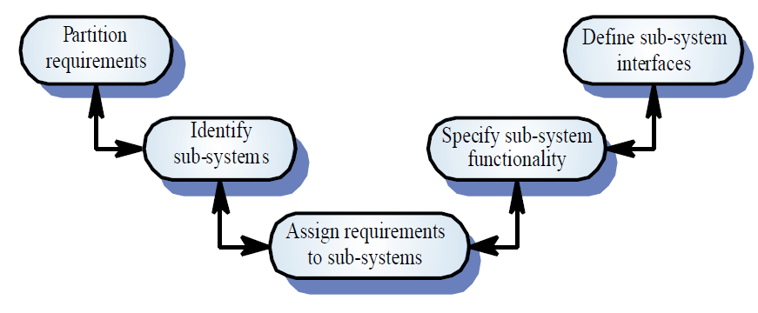
System design

Slide 24
System design
It is concerned with how the system functionality is to be provided by the different components of the system.
The various activities involved are:
Partition requirements: Analyze requirements and organize them into related groups. Many alternatives may be produced at this stage.
Identify sub-systems: Identify a set of sub-systems which collectively can meet the system requirements. Groups of requirements are usually related to sub-systems.
Assign requirements to sub-systems: The requirements are assigned to sub-systems. It may cause problems when COTS are integrated.

Slide 25
System design
The various activities involved are:
Specify sub-system functionality: The specific functions provided by each sub-system are specified. Relationships between sub-systems should also be identified at this stage.
Define sub-system interfaces: This involves defining the interfaces that are provided and required by each sub-system. Once these interfaces have been agreed, parallel development of the sub-systems become possible.
The double ended arrows imply that there is a great deal of feed back and iteration from one stage to another in this design process. As problems and questions arise, rework of earlier stages is often necessary.
There are many possible designs, cover range of solutions with different combination of h/w, s/w and human operators. Many factors influence the design selection. Eg if the system is a government system, it may prefer national rather than foreign suppliers even if the national product is technically inferior.

Slide 26
Sub-system development
Sub-systems identified during system design are implemented.
If a sub-system is a software system, a software process involving requirements, design, implementation, etc may be started.
Rarely, the development process will develop all sub-systems from scratch.
Normally, some of the sub-systems are commercial, off-the-shelf (COTS) systems that are brought for integration into the system.
It is usually much cheaper to buy existing products rather than develop.
Different sub-systems are usually developed in parallel.

Slide 27
System integration
Involves taking independently developed sub-systems and putting them together to make up a complete system.
Integration can be done using a big bang approach where all sub-systems are integrated at the same time.
But incremental integration process where sub-systems are integrated one at a time is best adopted.
Two reasons
It is usually impossible to schedule all the sub-system developments so that the development is completed at the same time.
It reduces the cost of error location.

Slide 28
System installation
The system is put into the environment in which it is intended to operate.
But installation of a complex system can take months or even years.
Environmental assumptions may be incorrect
The system may use functions provided by a specific version of the OS. When the system is installed, it may not work at all or may operate in a way that was not anticipated by the developers.
May be human resistance to the introduction of a new system
System may have to coexist with existing systems for some time
May be physical installation problems (e.g. cabling problems)
Operator training has to be identified

Slide 29
System operation
After installation, the system is put into operation
Operating the system may involve organizing training sessions for operators and changing the normal work process to make effective use of the new system.
Will bring undetected problems because system specification may contain errors or omissions.
Users may use the system in a way which is not anticipated by system designers
Problem of operating new system with existing systems.
Problem of incompatibility
Difficult to transfer data from one system to another
Introducing the new system may increase the operator error rate for existing systems as operators mix up user interface commands.

Slide 30
System evolution
Large systems have a long lifetime. They must evolve to meet changing requirements
The system’s computers are likely to be replaced with new, faster machines.
The organization which uses the system may reorganize itself and hence use the system in a different way.
The external environment of the system may change, thus forcing changes to the system.
System evolution is costly due to:
Changes must be analysed from a technical and business perspective
Sub-systems are never completely independent, changes to one sub system may adversely affect the performance of other sub-system. So change may be required.
There is rarely a recording of why the original design decisions was made.
As systems age, their structure typically becomes corrupted by change so the cost of making further changes increases.

Slide 31
System decommissioning
Taking the system out of service after its useful lifetime
May require removal of materials (e.g. dangerous chemicals) which pollute the environment
As far as software is concerned, no physical decommissioning problems.
Not worn components can be identified and reused in other systems.
May require data to be restructured and converted to be used in some other system

Slide 32
System procurement
Customers for complex systems are usually large organizations (military, government).
The system may be bought as a whole, may be bought as separate parts which are then integrated or may be specially designed and developed.
For large systems, deciding which of these options to choose take considerable time.
The system procurement is concerned with making decisions about the best way for an organization to acquire the system and deciding on the best suppliers of that system.
Some system specification and architectural design is usually necessary before procurement
You need a specification to let a contract for system development
The specification may allow you to buy a commercial off-the-shelf (COTS) system. Almost always cheaper than developing a system from scratch

Slide 33
System procurement process
Customers for complex systems are usually large organizations (military, government).
The system may be bought as a whole, may be bought as separate parts which are then integrated or may be specially designed and developed.
For large systems, deciding which of these options to choose take considerable time.
The system procurement is concerned with making decisions about the best way for an organization to acquire the system and deciding on the best suppliers of that system.
Some system specification and architectural design is usually necessary before procurement
You need a specification to let a contract for system development
The specification may allow you to buy a commercial off-the-shelf (COTS) system. Almost always cheaper than developing a system from scratch

Slide 34
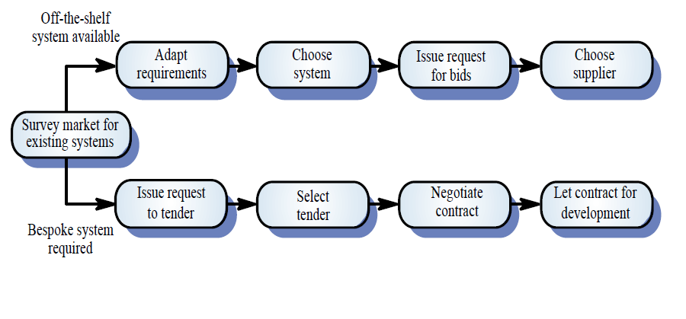
System procurement process

Slide 35
System procurement process
Off the shelf components don’t usually match the requirements exactly. So choosing a system means finding the closest match between the system requirements and the facilities offered by off the shelf systems. The requirement may have to be modified.
When a system is to be built specially, the specification of requirements acts as the basis for the contract for procurement.
After a contractor to build a system has been selected, there is further contract negotiation period where further changes to the requirements may be agreed and issues such as the cost of change discussed.

Slide 36
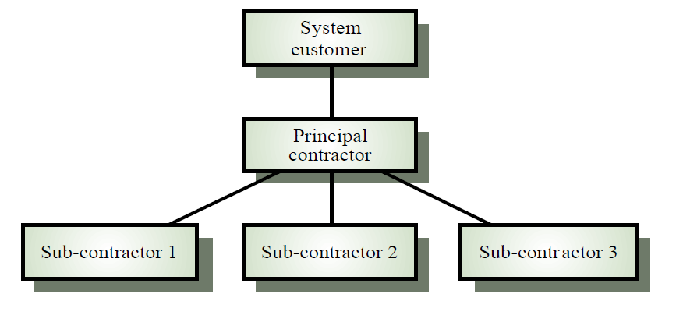
System procurement process
Very few single organizations have the capabilities to design, manufacture and test all the components of large complex system.
This supplier, the principal contractor may contract out the development of different sub-systems to a no of subcontractors.

